Slide 1
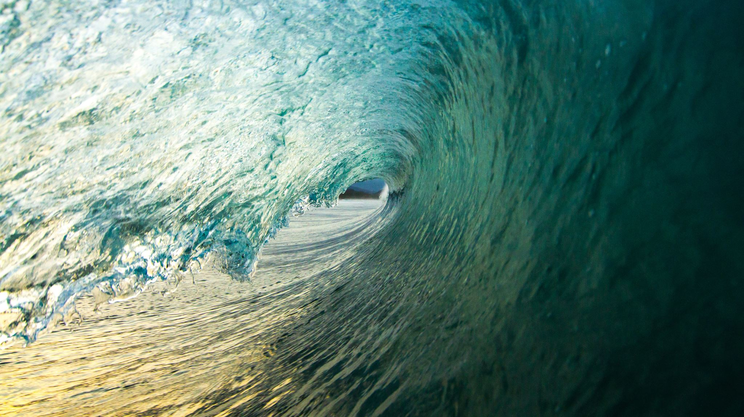
Am I Drinking Enough Water?
An analysis of daily water consumption

Slide 2

QUESTION
Do I drink the recommended 1/2 oz (~15ml) of water per pound of body weight per day?
For me, that’s approximately 2810ml per day.
I did not check the amount I needed to drink prior to collecting the data.

Slide 3
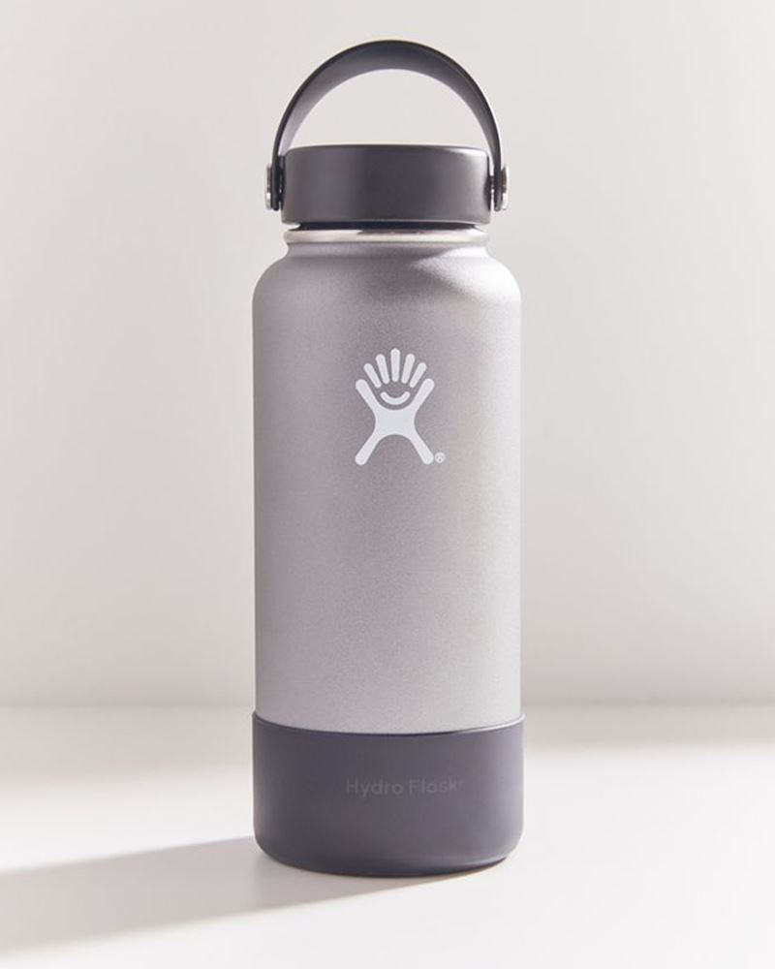
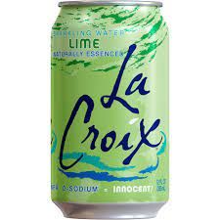
DATA
Date | Amount(mL) | Enough?
15-Nov | 2955 | Y
16-Nov | 2560 | N
17-Nov | 3800 | Y
18-Nov | 4565 | Y
19-Nov | 3000 | Y
20-Nov | 2435 | N
21-Nov | 2745 | N
22-Nov | 2820 | Y
23-Nov | 3100 | Y
24-Nov | 2955 | Y
25-Nov | 3240 | Y
26-Nov | 3470 | Y
27-Nov | 2640 | N
28-Nov | 3215 | Y
29-Nov | 2925 | Y
15 observations
Variables
Independent: Date
Dependent: Amount consumed in milliliters

Slide 4
Hypothesis Testing
Claim: On average I do not drink the recommended 2810ml of water per day.

Slide 5
Hypothesis Testing
Step 1
H₀: Mean water consumption per day <= 2810ml
H_{a}: Mean water consumption per day > 2810ml
Step 2
Use t-test

Slide 6
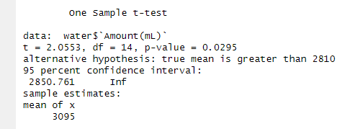
Hypothesis Testing
Step 3
Test Statistic
T = 2.0553
P-value: 0.0295
Step 4
Using a significance level of 0.05, we can reject H₀ and confirm H_{a}

Slide 7
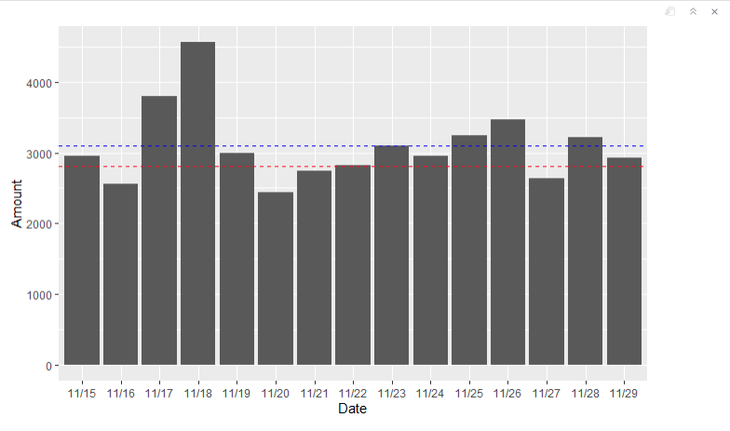
Conclusion
Since the p-value of 0.0295 is less than 0.05, we can reject the null hypothesis. There is enough evidence to support the claim that my mean water consumption is greater than the recommended amount of 2810ml.
My average (3095ml)
Recommended amount (2810ml)

